Slide 1
EXCEL PROJECT ON DASHBOARD DASHBOARD ON UNIVERSITY
SUBMITTED BY:
Sneha singh

Slide 2
PROBLEM STATEMENTS
ADMISSIONS(YEAR WISE)
COURSE
STREAME
NUMBER OF STUDENTS(BY STATE)
PLACEMENT(YEAR WISE)
RESULT
SCHOLARSHIP
SOURCE: https://www.shiksha.com/university/lpu-lovely-professional-university-jalandhar-28499

Slide 3
EXECUTIVE SUMMARY
STUDENT DETAIL : This excel file contains the details of only 300 students from year 2015 to 2019. Details like name,id,course,year of admission.
PLACEMENT : This excel file contains details of the students placed each year from 2018 to 2020. and also package details.
SCHOLARSHIP : This excel contains the detail of those students who has benifited by scholarship.
RESULT : This excel file contains the result analysis.
DASHBOARD : This excel file contains all charts or graphs.
VIDEO LINK : https://drive.google.com/file/d/1FyJuSgalUslat-MB9zvb5ajyd0CC3-uz/view?usp=sharing

Slide 4
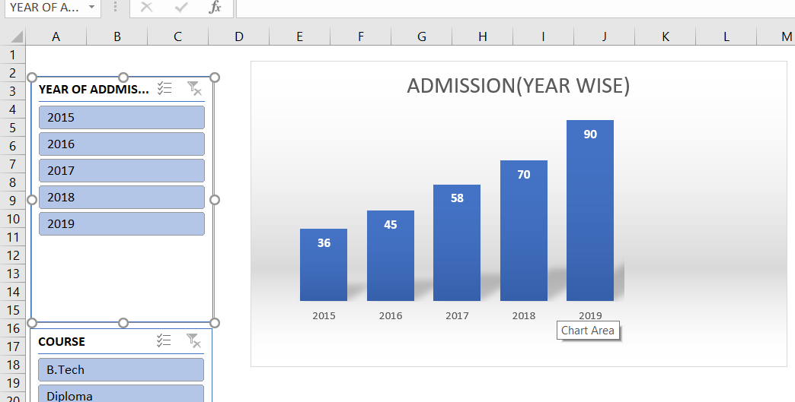
BASIC ANALYSIS

Slide 5
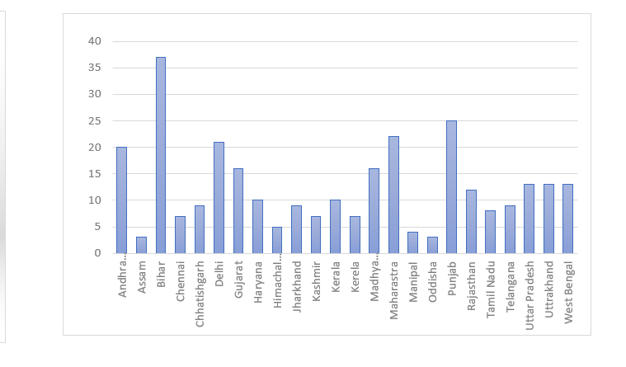
The above shown graph shows that the admission rate per year increases.
Graph shown below shows the number of students from different states.

Slide 6
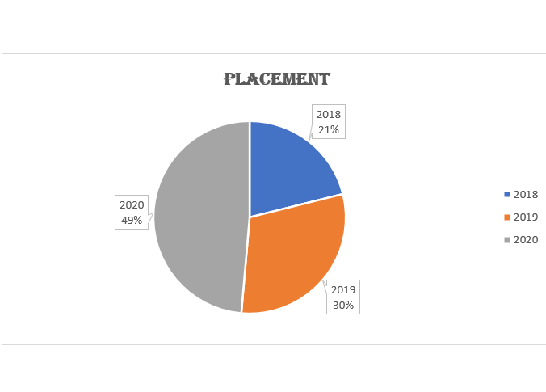
The below given graph shows the placement rate from 2018-2020.

Slide 7
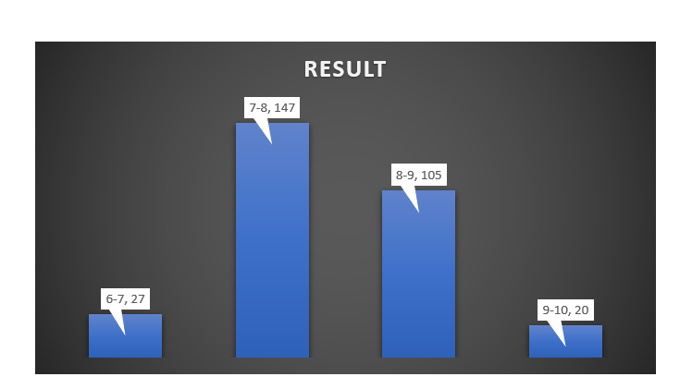
This graph shows the number students grouped in different CGPA for result analysis.

Slide 8
CONCLUSION
In Last I want to conclude that this university is on the way to success. As the admission rate per year continuously increasing.It’s Placement rate,placement package all are increasing per year.It’s all graph is in increasing graph.

Slide 9
THANK YOU

